Slide 1
“Examination of Human Blood Group and Rh Factor”
Class- B.Sc. III Year Practical
Date: 19.09.2020
Time: 03:00-05:00PM
Presented by
Manoj Joshi
Department of Zoology
UCoS,MLSU, Udaipur.

Slide 2
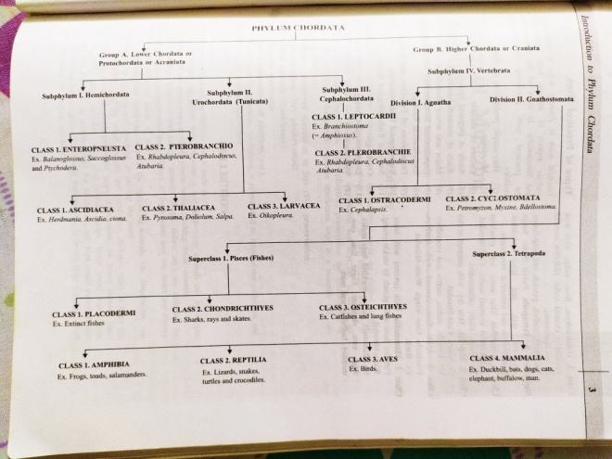
Type of Blood Groups
Karl Landstenier (1900) discovered Blood group . According to him absence and presence of A and B agglutiongenes or A and B antigens in RBC Blood groups can be classified.
S. No. | Blood group | Antigen | Antibody
1 | A | B | A
2 | B | A | B
3 | AB | A and B | -
4 | O | - | a&b

Slide 3
Type of Blood Groups
Requirements- Cavity slides, Blood sample vials or small glass tubes, Antiserum A, Antiserum B and Antiserum D.
Procedure-
Sterilize middle finger tip.
Prick the sterilized finger with a sterilized needle.
Collection of blood sample in vial containint 1 ml of 85% NaCl. (85% NaCl- 0.85gm NaCl dissolved in 100 ml DW)
Take 2 cavity slides which with 4 cavity.
Add a drop of 4 different sample of blood in each cavity.
In slides cavities add different Antiserum in sequance.

Slide 4
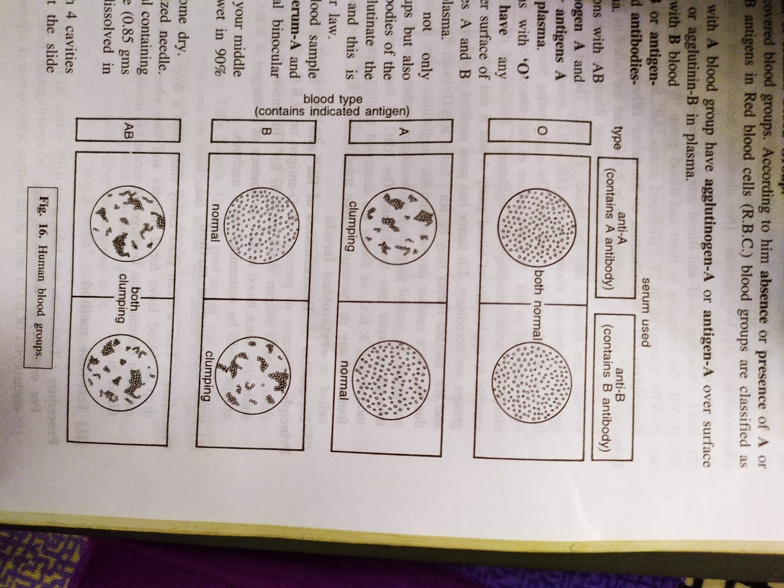
Observation- As per the Clumping in different cavity we can conclude the results.

Slide 5
A
B
D

Slide 6
Thank You

